Slide 1

NEWS CLASSIFICATION
D M Murali Krishna Reddy
Battu Varshit

Slide 2
News Classification
We focused mainly on classifying the news into five categories namely Technology, Business, Entertainment, Sports, Politics.
Corpus
BBC Insights News Dataset having around 2225 documents.

Slide 3
Tools and techniques going to be used
Tools
NLTK
NumPy
SciPy
Techniques
Naive bayes
Random Forests

Slide 4
Implementation
We implemented the Bayes and Random Forest technique by taking the first 2000 most occurring words as the vocabulary.
We had to remove the common words like The, a, an etc which do not contribute to the classification.
We used the stop words included in the NLTK library to remove them from the vocabulary.

Slide 5
Training
We randomly take 50 documents from the dataset as input and run the classifier on them after training is done on the remaining dataset.
The results for Multi Variate Bernoulli
 | Politics | Sport | Tech | Business | Entertainment | Accuracy
Politics | 45 | 0 | 1 | 3 | 1 | 0.90
Sport | 13 | 37 | 0 | 0 | 0 | 0.74
Tech | 11 | 0 | 39 | 0 | 0 | 0.78
Business | 14 | 0 | 5 | 31 | 0 | 0.62
Entertainment | 13 | 0 | 1 | 1 | 35 | 0.70

Slide 6
Training
The results for Normalized Multinomial
 | Politics | Sport | Tech | Business | Entertainment | Accuracy
Politics | 47 | 1 | 0 | 2 | 0 | 0.94
Sport | 16 | 33 | 0 | 0 | 1 | 0.66
Tech | 47 | 0 | 3 | 0 | 0 | 0.06
Business | 24 | 0 | 1 | 25 | 0 | 0.50
Entertainment | 10 | 0 | 0 | 1 | 39 | 0.78

Slide 7
Random Forest
Random Forest uses decision trees to classify the input.
We went till a depth of 10 or till a node whose entropy is zero.
We randomly split the available data into training and testing sets.
The decision trees are built by selecting a fraction of the training data.
We give the test data to every decision tree and classify them by assigning the class with the highest frequency.

Slide 8
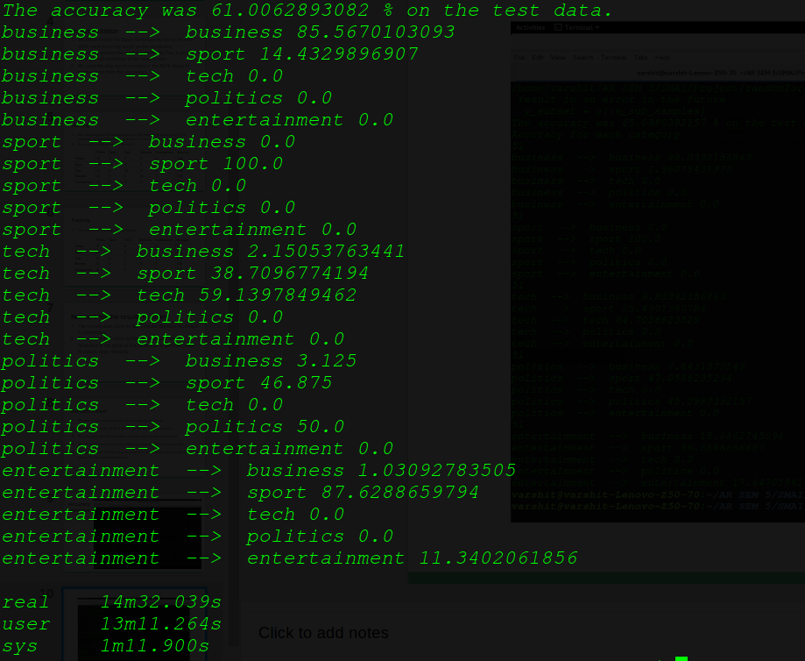
Accuracy achieved
32 Trees
Depth 10

Slide 9
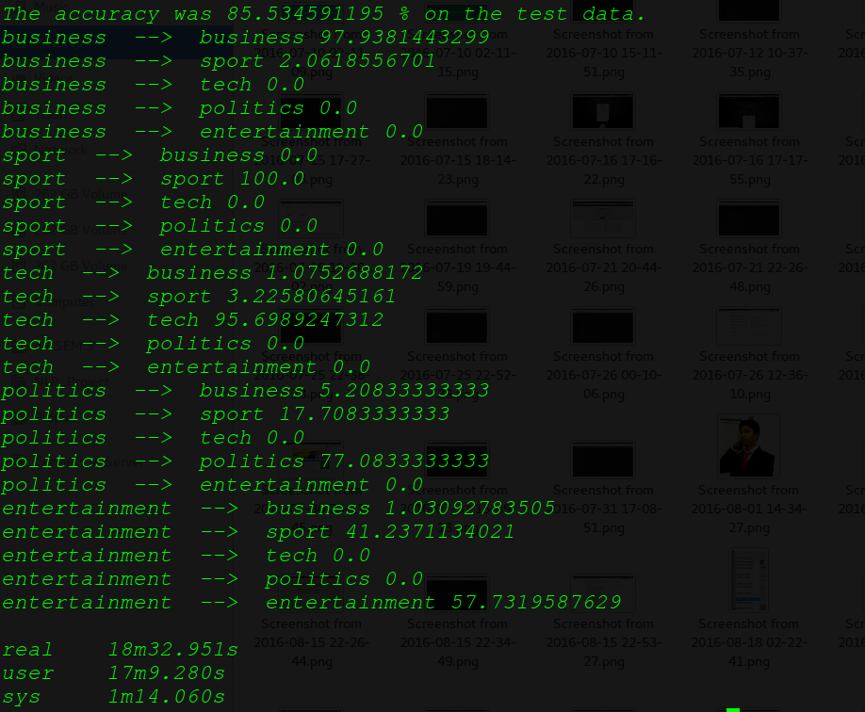
32 Trees
Depth 10

Slide 10
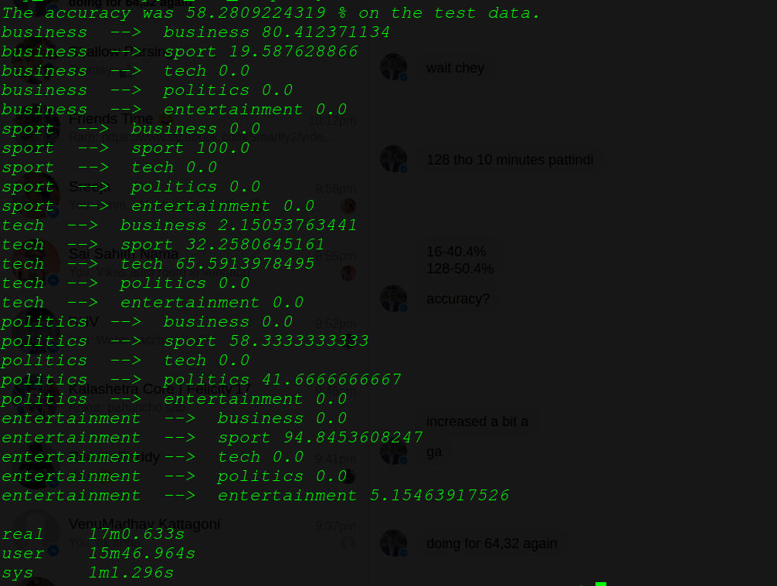
32 Trees
Depth 10

Slide 11
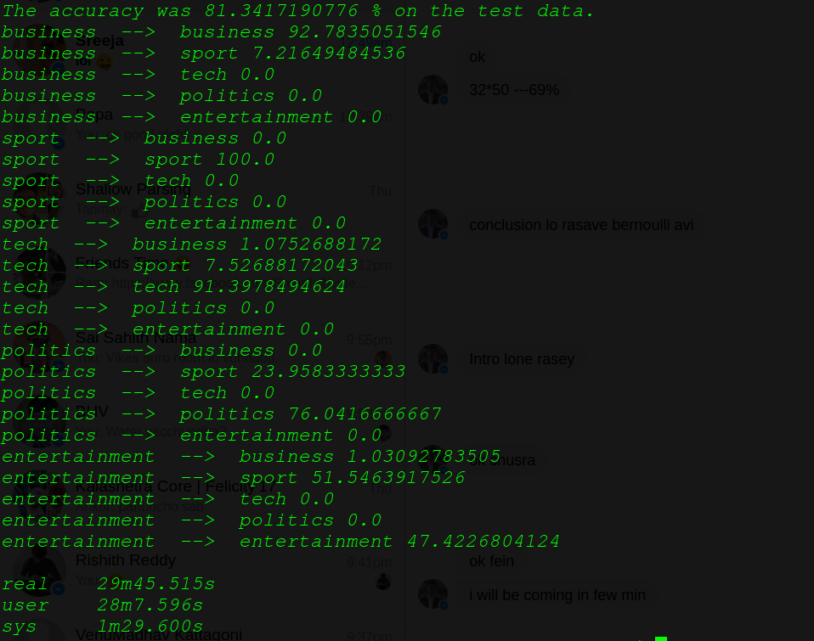
32 Trees
Depth 10

Slide 12
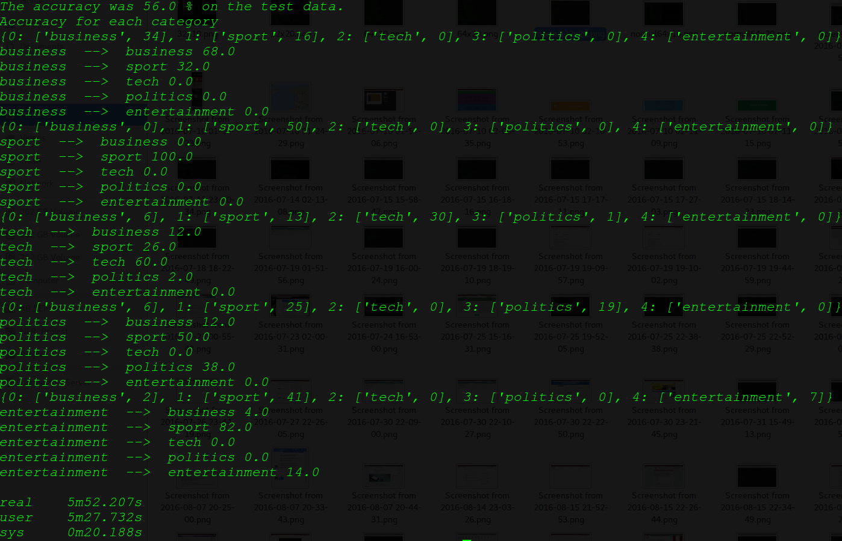
32 Trees
Depth 10

Slide 13
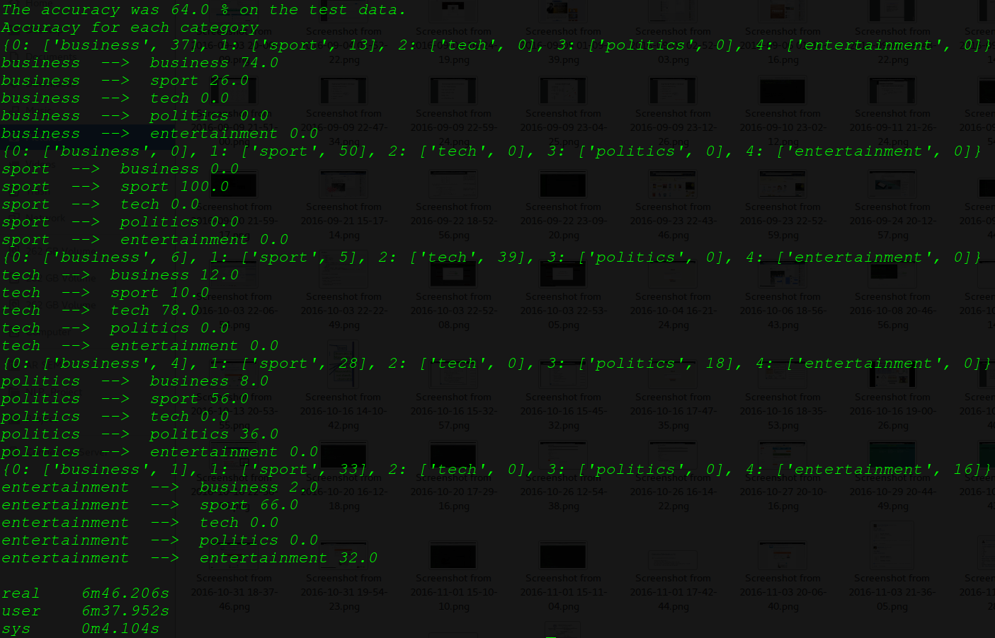
32 Trees
Depth 20

Slide 14
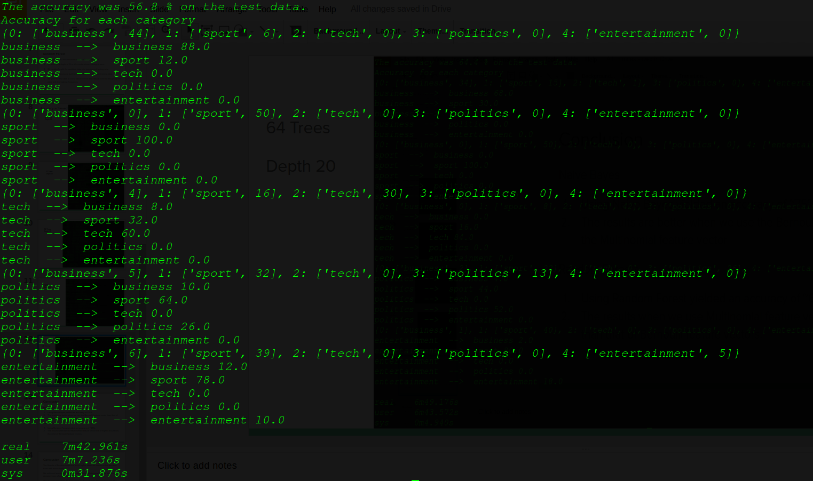
64 Trees
Depth 10

Slide 15
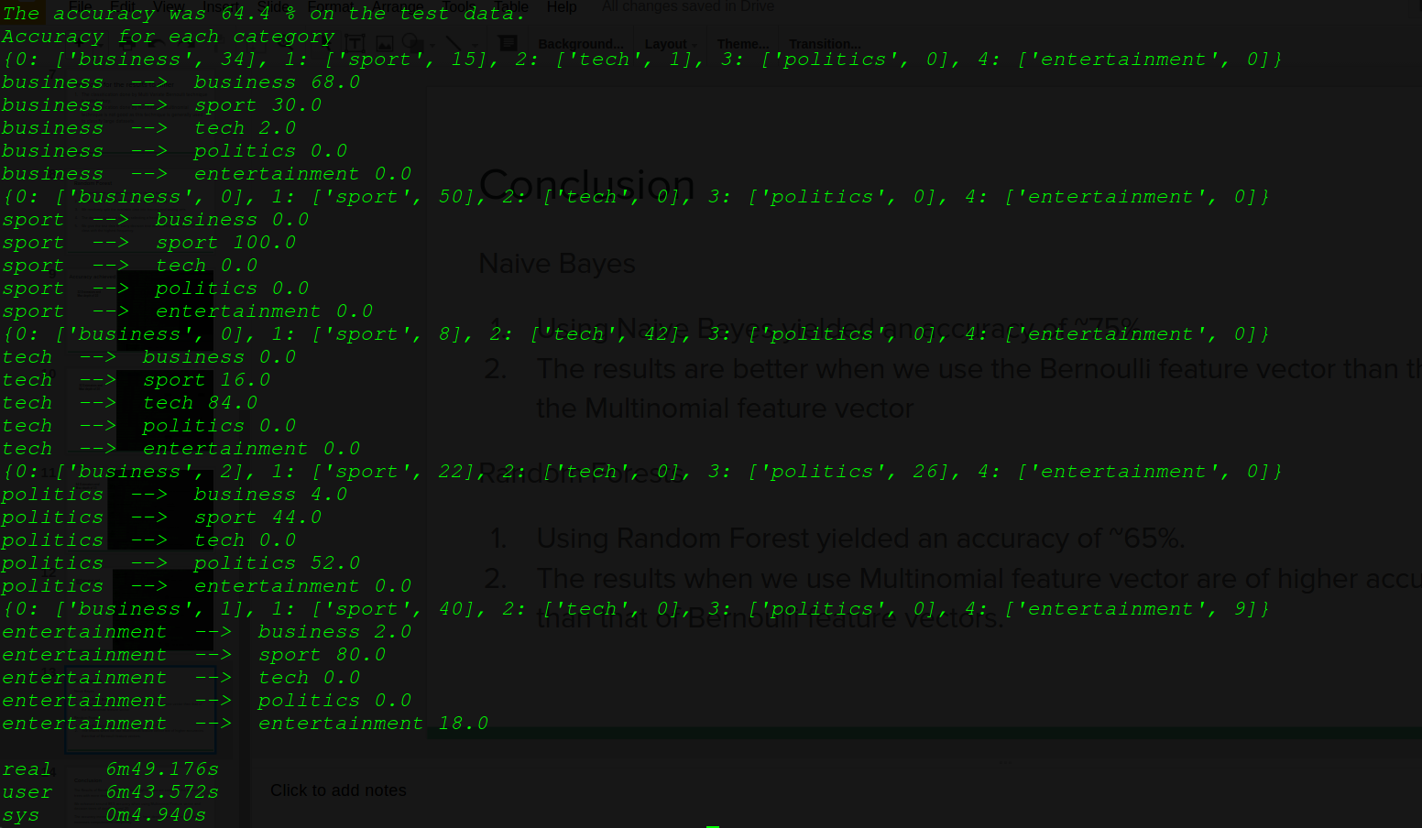
64 Trees
Depth 20

Slide 16
Conclusion
Naive Bayes
Using Naive Bayes yielded an accuracy of ~75%.
The results are better when we use the Bernoulli feature vector than that of the Multinomial feature vector
Random Forests
Using Random Forest yielded an accuracy of ~65%.
The results when we use Multinomial feature vector are of higher accuracies than that of Bernoulli feature vectors.

Slide 17
Conclusion
The Results of Random forest are much higher when we construct the decision trees with more depth.
We achieved around 85% accuracy when using Multinomial Feature vector and decision trees of depth around 20.
The accuracy increases far more when we have deeper decision trees but also increases computational complexity.

